Slide 1

HOME AUTOMATION
Using esp32 and sinricPro
BY
Tharshika P

Slide 2
CONTENTS
Introduction
Components
Basic Steps
ESP 32 pin diagram
Circuit Diagram
Working
Flowchart
Advantages
Conclusion

Slide 3
INTRODUCTION
Home automation or domotics is building automation for a home, called a smart home or smart house. A home automation system will monitor and/or control home attributes such as lighting, climate, entertainment systems, and appliances. It may also include home security such as access control and alarm systems. When connected with the Internet, home devices are an important constituent of the Internet of Things ("IoT").

Slide 4
COMPONENTS
Esp32
4-channel relay module
Jumper wires
Bulb
Push Buttons

Slide 5
BASIC STEPS
Control 3 relays with Google Assistant and switches.
Create an account and add devices in Sinric Pro
Programming the ESP32 with Arduino IDE
Connect Sinric Pro with Google Home App

Slide 6
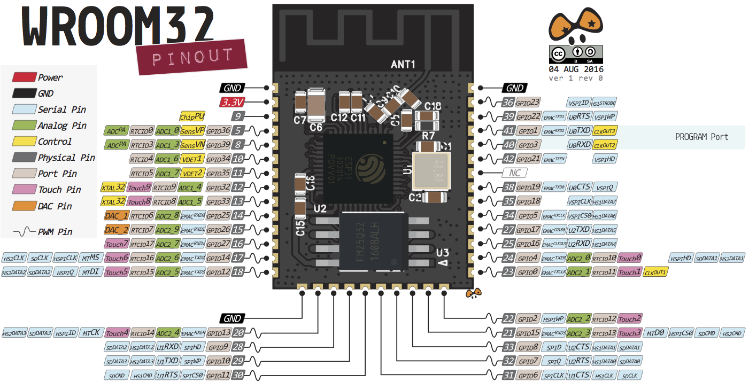
ESP 32 Pin Diagram

Slide 7
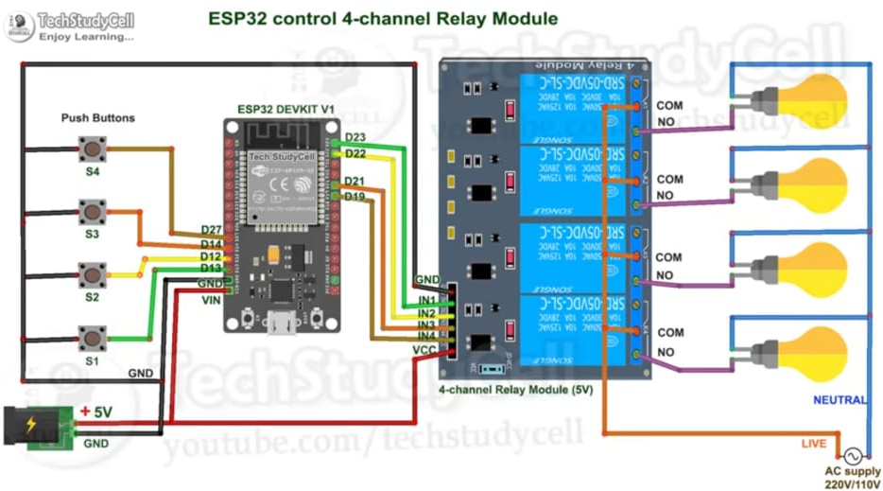
CIRCUIT DIAGRAM

Slide 8
WORKING
The commands given through the Google assistant are decoded and then sent to the microcontroller, the microcontroller in turn control the relays connected to it. The device connected to the respective relay can be turned ON or OFF as per the users request to the Google Assistant. The micro-controller used here is ESP 32Basically, esp32 is a micro-controller that has in-built Wi-Fi and Bluetooth. So, we will connect our home appliances with Wi-Fi and control them using our mobile. Automation (such as home automation and industrial automation etc) has become important in today’s

Slide 9
FLOWCHART
START
ESP Module connected to network
Sinric app connected
By application command are given to the Module
STOP
Relay Switch react on that command
Module give command to relay switch

Slide 10
#define WIFI_SSID “tharshi”
#define WIFI_PASS “tharshiiregal”
#define APP_KEY “7d4adf5d-5e0e-4a49-9070-3c564635fb03”
#define APP_SECRET “3fd851af-5d5c-4060-8954-4cff73eb350d-bef31988-165c-442f-afba-1188446f8862”
#define device_ID_1 “641a91e91bb4e19c11bd3b2c”
#define device_ID_2 “641a92105ec7d92a472c54c2”
#define RelayPin1 23
#define RelayPin2 22
#define SwitchPin1 13
#define SwitchPin2 12
#define ENABLE_DEBUG
#ifdef ENABLE_DEBUG
#define DEBUG_ESP_PORT Serial
#define NODEBUG_WEBSOCKETS
#define NDEBUG
#endif
#include <Arduino.h>
#include <WiFi.h>
#include “SinricPro.h”
#include “SinricProSwitch.h”
#include <map>

Slide 11
pinMode(flipSwitchPIN, INPUT_PULLUP);
}
}
Bool onPowerState(String deviceId, bool &state)
{
Serial.printf(“%s: %s\r\n”, deviceId.c_str(), state ? “on” : “off”);
Int relayPIN = devices[deviceId].relayPIN;
digitalWrite(relayPIN, !state);
return true;
}
Void setupFlipSwitches() {
For (auto &device : devices) {
flipSwitchConfig_t flipSwitchConfig;
flipSwitchConfig.deviceId = device.first;
flipSwitchConfig.lastFlipSwitchChange = 0;
flipSwitchConfig.lastFlipSwitchState = true;
int flipSwitchPIN = device.second.flipSwitchPIN;
flipSwitches[flipSwitchPIN] = flipSwitchConfig;

Slide 12
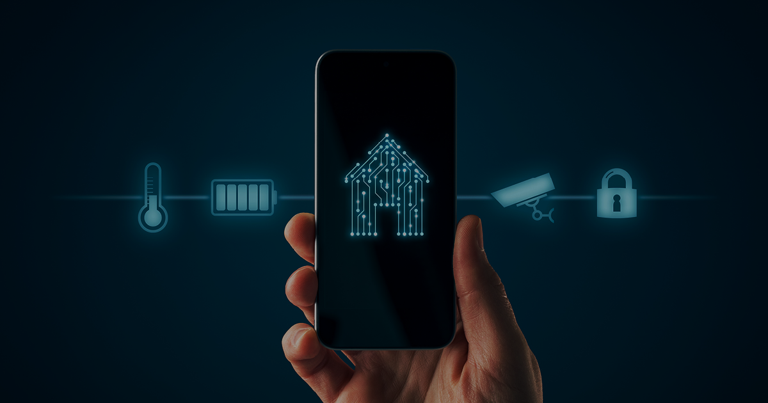
ADVANTAGES
Remote access
Comfort
Convenience
Increased Safety
Energy Efficiency

Slide 13
CONCLUSION
Home electrical appliances are using remote-controlled switches rather than conventional switches. In today’s world, most of the people have access to smartphones and its use have become very popular and essential in our lives. We can use smartphones to control the household appliances with just one click or one message. With the help of controllers and communication devices home appliances can be remotely controlled.

Slide 14
THANK YOU

